Slide 1
Brain Tumor Segmentation
Using Cascading Neural Networks
Implementation of
Brain Tumor Segmentation with Deep Neural Networks

Slide 2
Technologies Used
Keras
TensorFlow Backend
Jupyter notebook : Interactive iPython notebook interface
Google Colab : Provides free remote access to GPU

Slide 3
Problem Statement
For patients with brain tumor, physical symptoms vary from patient to patient
Some patients don’t even show general symptoms
MRI scans of patients are more reliable than physical symptoms
We pose this problem as:
From MRI scan images, automatic detection and labeling of the tumor regions, pixel-wise
Previous works uses manually build features which are then use to detect tumor regions
For some type of tumors like gliomas and glioblastomas, detection is very hard as discerning features are rare
So such generic features are less likely to work out
To tackle this problem, Authors of paper Brain Tumor Segmentation with Deep Neural Networks propose end-to-end deep learning pipeline which learns the features in iterations for better performance on the given task.

Slide 4
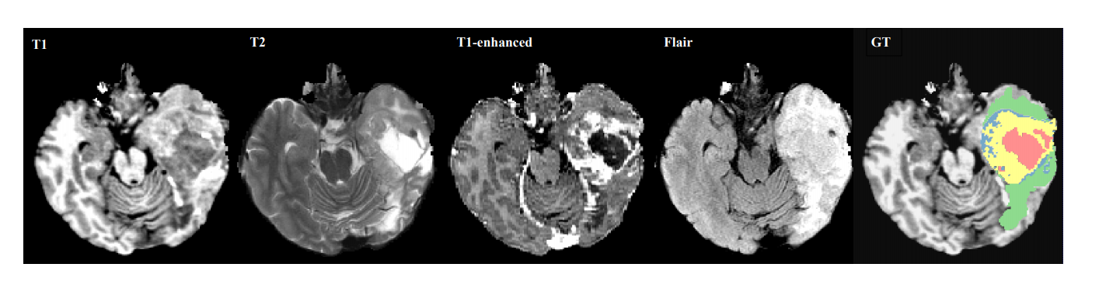
Dataset Specifications
Dataset used is BRATS 2013 dataset
Dataset consists of 4 modalities( different types of scans) namely T1, T1C, T2 and T2-FLAIR
For each patient and each modality, we get a 3D image of brain
We are concatenating the 4 modalities as 4 channels slice-wise
The slices in 4 modalities and ground truth labels are as shown-

Slide 5
Dataset Specifications
The 5 labels for ground truth are:
1 : For necrosis
2 : For edema
3 : For non-enhancing tumor
4 : For enhancing tumor
5 : For everything else

Slide 6
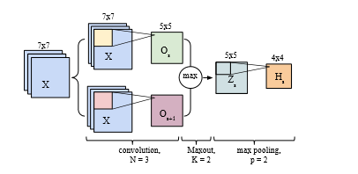
Proposed model architecture
Fully convolutional neural network model
Takes a (33 x 33 x 4) patch from slice, produces one-hot encoding for 5 labels
Layers used : Convolutional layers, max-pooling, max-out, Dropout(implemented in paper)

Slide 7
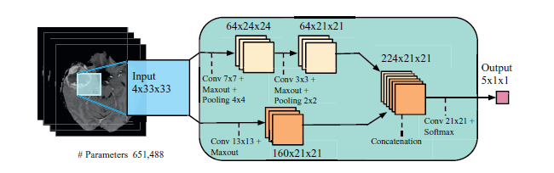
TwoPathCNN architecture
Two paths : Local and global path
Local path has small kernel filters, processes smaller details
Global path has larger kenel size, enabling much more global feature extraction

Slide 8
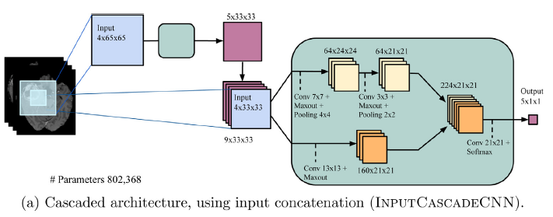
Cascading Architectures
These architectures are created using joining two TwoPathCNN architectures together
InputCascadeCNN : 1st output joined to 2nd input
MFCcascadeCNN : 1st output joined to 2nd output
LocalCascadeCNN : 1st output joined to 2nd local path’s 1st activation

Slide 9
Skewed Dataset Problem
From the all pixels together of tumor patients, only 2% of total are actual tumor pixels
This is huge bias towards non-tumor regions
Training a model with this true distribution will lead to model only outputting label 0 i.e., a local minima
Such learnt features are useless
To Tackle This Skewed Dataset Problem . . .

Slide 10
Two Way Training
The authors propose a novel training methodology for training
First, take a equiprobable distribution of patches(dataset) and train the model on it
Then, train this model on true distribution again
Training this way, model does not get stuck into local minima
Fine-tuning on true distribution removes the bias induced by equiprobable distribution

Slide 11
My Approach
Changed the categorical loss function to weighted categorical loss
Trained the model per slice
Calculated the weights using label distribution of given slice
Added Batch Normalization, which smothens the convex optimization plane for smoother gradients (Santurkar et. al)

Slide 12
Thank You

